Slide 1



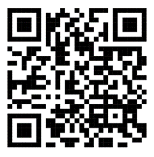
The GiveBack Project: Presentation of Concept Note and Discussion
Time: Saturday, January 13th, 2024, 07:00 PM Cameroon/ 01:00 PM New York City / 06:00 PM GMT
Zoom Meeting ID: 881 5700 6391 Passcode: 237
This meeting is open to the general public
Zoom Meeting ID: 881 5700 6391 Passcode: 237
This meeting is open to the general public
Town Hall Moderators

